Slide 1

Different Learning Styles and Types of Mentors to help you thrive and succeed - One size need not fit all.
Vaishnavi Venkata Subramaniam

Slide 2

You don’t need a mentor

Slide 3

Mentors
Tiers
A’s and C’s
Personal Board of Directors
Traditional One-on-one Mentoring
Distance Mentoring
Group Mentoring
Availability, Active listening, and Analysis
Consultant, Counselor, and Cheerleading
Trusted team of individuals who have personal and professional skills, experience and insights and provide support, guidance and advice.

Slide 4

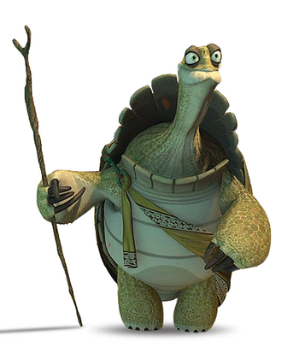




The master of craft - iconic
Personal Jedi master - intuition, rigorous training, and intensive self-discipline
Master Oogway - Highly venerated for his wisdom, knowledge, and experience
Unacquainted
Notes:
Highly venerated for his wisdom, knowledge, and experience, Oogway was considered by many to be a sage

Slide 5
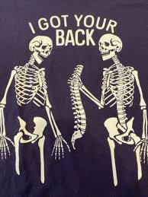
The champion of your cause- connectors
Advocates
Introducing you to useful people in your industry

Slide 6

The copilot- work bud
Listen to you vent over coffee
Peers committed to supporting each other

Slide 7

The anchor- When you hit the speedbumps
A confidante and a sounding board
Give us a psychological lift
A friend/family member

Slide 8

The reverse mentor - counterpoint
Perspectives fresh and relevant
collect feedback on leadership style

Slide 9
Learning Styles

Slide 10
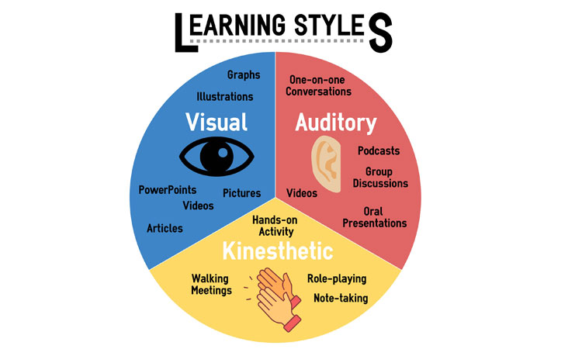
Learning Styles
Unique
Tested
Only product specifically dedicated to this niche market
Conducted testing with college students in the area
First to market
Authentic
First beautifully designed product that's both stylish and functional
Designed with the help and input of experts in the field

Slide 11
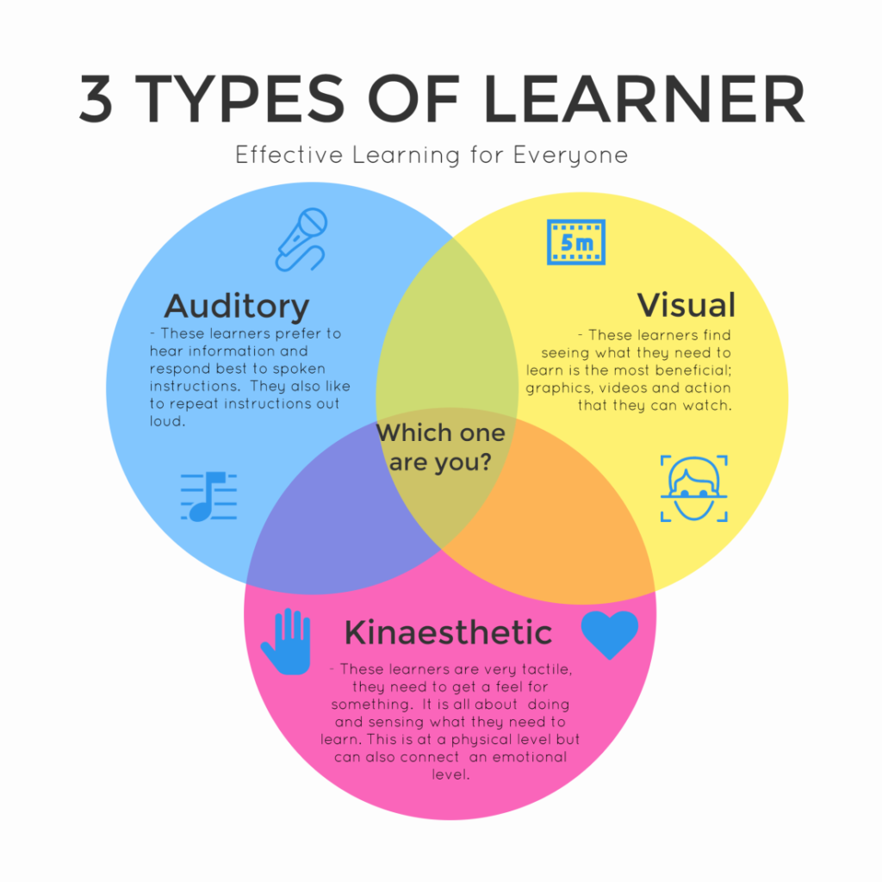

What’s your style
Touch and feel
Tactile Learners, also commonly referred to as Kinesthetic Learners, are hands-on learners
Auditory learners
Able to learn, understand and retain information better when they hear it rather than see it.
Mixed bag?
Not static. You can develop ability in less dominant styles, as well as further develop styles that you already use well.
Additional learning styles and preferences
Logical (mathematical), Social (interpersonal) and Solitary (intrapersonal).

Slide 12

Problem
Market gap
Financials
Few, if any, products on the market help customers like we do
Millennials account for about a quarter of the $48 billion spent on other products in 2018
Customers
Costs
66% of US consumers spend money on multiple products that only partially resolves their issue
Loss of productivity costing consumers thousands of dollars

Slide 13

The Bottom Line
Mutual Respect
Active Listening
Honest Feedback

Slide 14
Company overview

Slide 15



Business model
Research
Abstract
Design
We based our research on market trends and social media
We believe people need more products specifically dedicated to this niche market
Minimalist and easy to use

Slide 16
Market comparison
$3B
Opportunity to build
Addressable market
$2B
Freedom to invent
Serviceable market
$1B
Few competitors
Obtainable market

Slide 17
Our competition
Contoso
Competitors
Our product is priced below that of other companies on the market
Design is simple and easy to use, compared to the complex designs of the competitors
Affordability is the main draw for our consumers to our product
Company A Product is more expensive
Companies B & C Product is expensive and inconvenient to use
Companies D & E Product is affordable but inconvenient to use

Slide 18
Competitive layout
CONVENIENT
A
Contoso
EXPENSIVE
AFFORDABLE
D
C
E
B
INCONVENIENT

Slide 19
Growth strategy
How we’ll scale in the future
Feb 20XX
May 20XX
Oct 20XX
Roll out product to high profile or top-level participants to help establish the product
Release the product to the general public and monitor press release and social media accounts
Gather feedback and adjust product design as necessary

Slide 20
Traction
Forecasting for success
Key metrics
Revenue by year
 | Clients | Orders | Gross revenue | Net revenue
20XX | 10 | 1100 | $10,000 | $7,000
20XX | 20 | 200 | $20,000 | $16,000
20XX | 30 | 300 | $30,000 | $25,000
20XX | 40 | 400 | $40,000 | $30,000

Slide 21
Two-year action plan
Draft blueprints
Run focus groups
Gather feedback
20XX
JAN
FEB
MAR
APR
MAY
JUN
JUL
AUG
SEP
OCT
NOV
DEC
20XX
JAN
FEB
MAR
APR
MAY
JUN
JUL
AUG
SEP
OCT
NOV
DEC
Test design
Launch design
Deliver to client

Slide 22
Financials
 | Year 1 | Year 2 | Year 3
Income
Users | 50,000 | 400,000 | 1,600,000
Sales | 500,000 | 4,000,000 | 16,000,000
Average price per sale | 75 | 80 | 90
Revenue @ 15% | 5,625,000 | 48,000,000 | 216,000,000
Gross profit | 5,625,000 | 48,000,000 | 216,000,000
Expenses
Sales & marketing | 5,062,500 | 38,400,000 | 151,200,000 | 70%
Customer service | 1,687,500 | 9,600,000 | 21,600,000 | 10%
Product development | 562,500 | 2,400,000 | 10,800,000 | 5%
Research | 281,250 | 2,400,000 | 4,320,000 | 2%
Total expenses | 7,593,750 | 52,800,000 | 187,920,000

Slide 23




Meet the team
Takuma Hayashi
Mirjam Nilsson
Flora Berggren
Rajesh Santoshi
President
Chief Executive Officer
Chief Operations Officer
VP Marketing

Slide 24








Meet the team
Takuma Hayashi
Mirjam Nilsson
Flora Berggren
Rajesh Santoshi
President
Chief Executive Officer
Chief Operations Officer
VP Marketing
Graham Barnes
Rowan Murphy
Elizabeth Moore
Robin Kline
VP Product
SEO Strategist
Product Designer
Content Developer

Slide 25
Funding
Properties
Angel investments
Cash
Shares
$12,000
$14,000
$32,000
$82,000
Revenue obtained from property rentals
Amount obtained through other investors
Liquid cash we have on hand
Number of shares converted into USD

Slide 26
Summary
“A mentor is someone who sees more talent and ability within you, than you see in yourself, and helps bring it out of you.” — Bob Proctor.

Slide 27


Thank you
Vaishnavi V
Source : https://ideas.ted.com/the-5-types-of-mentors-you-need-in-your-life/
Notes:
Source : https://ideas.ted.com/the-5-types-of-mentors-you-need-in-your-life/

